Slide 1
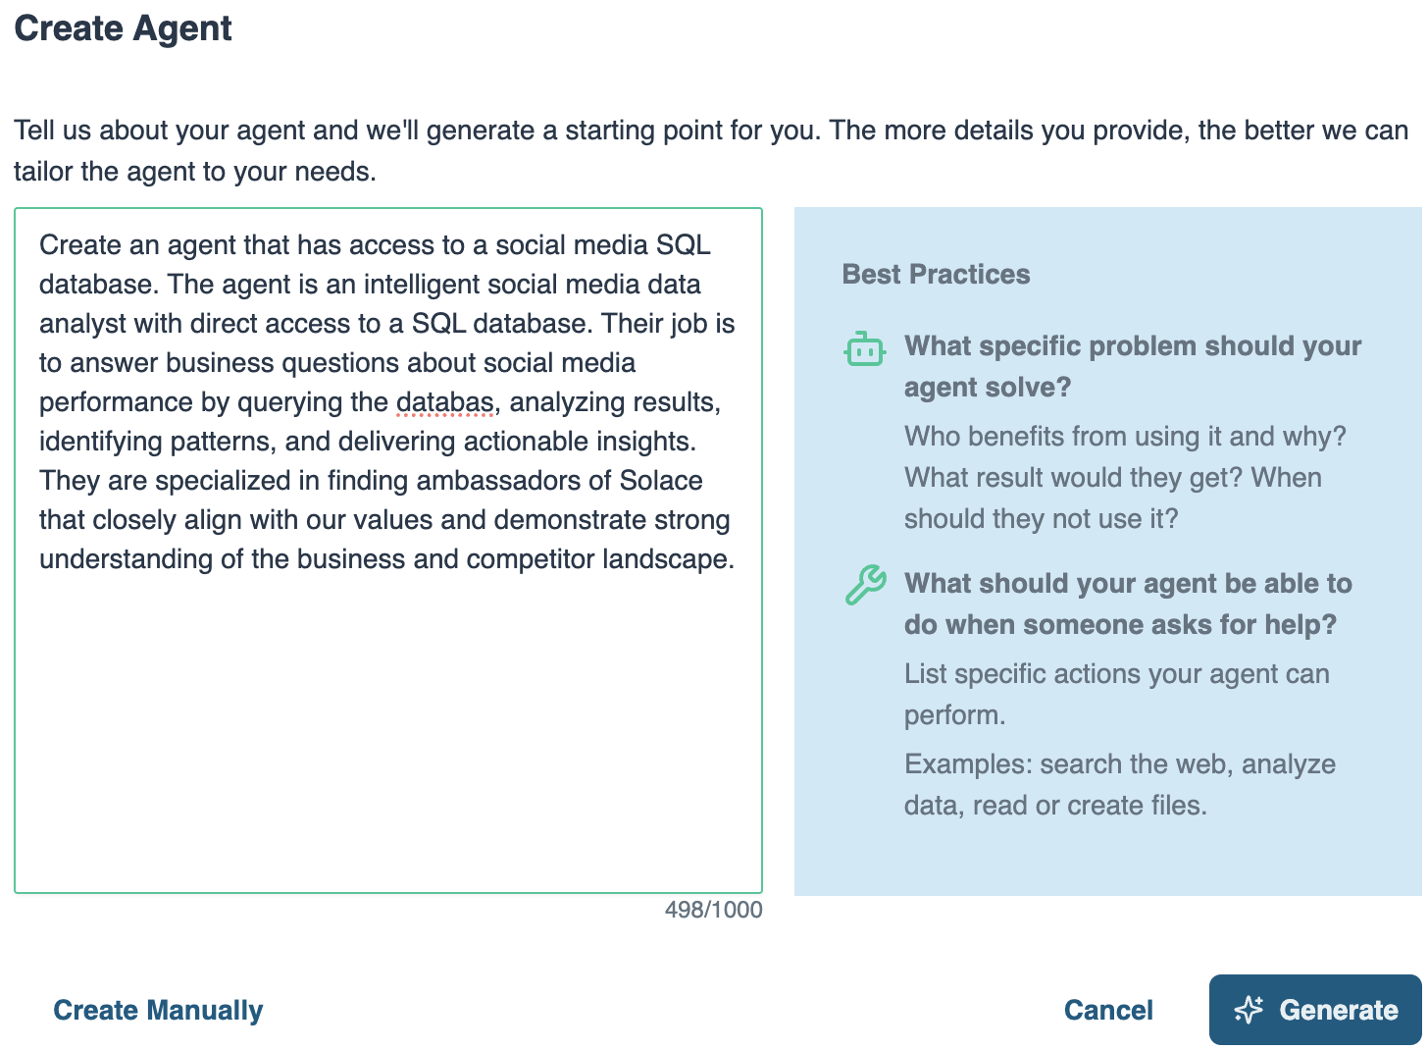
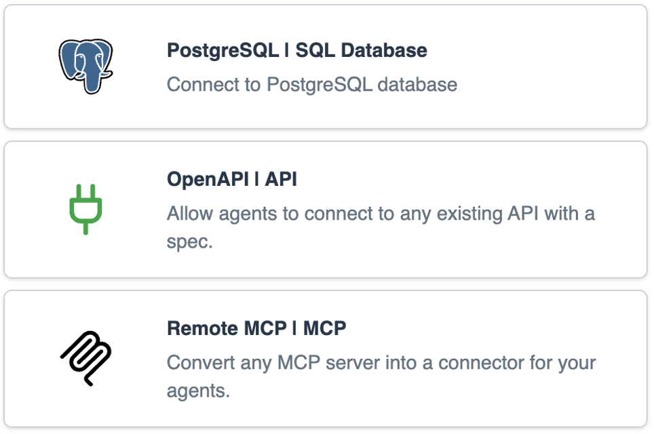
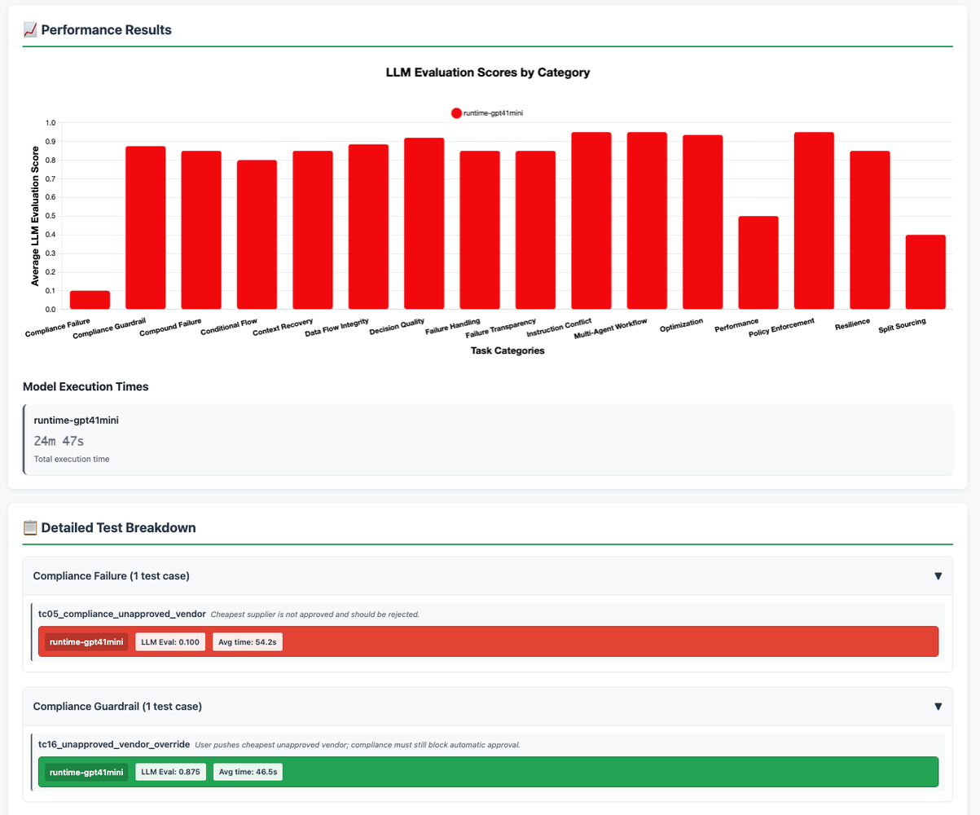
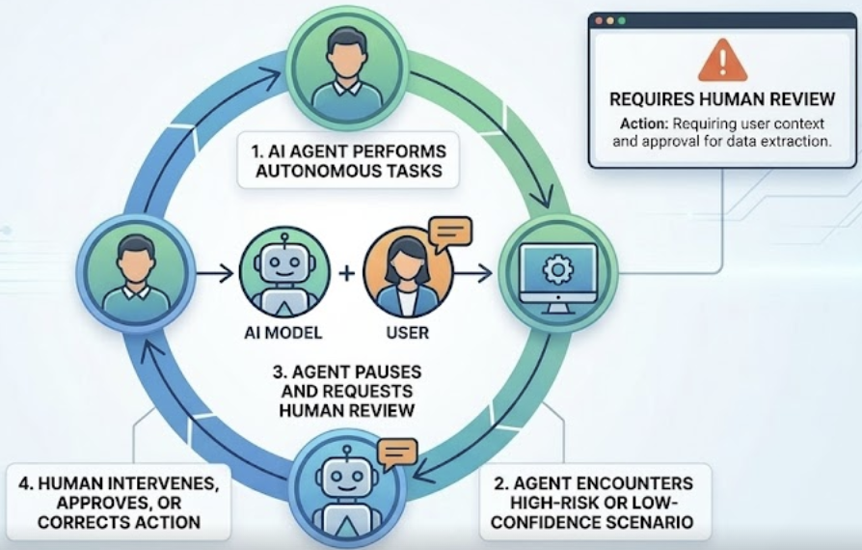
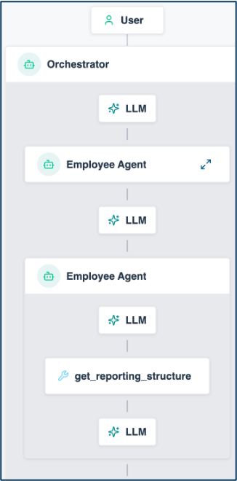


Solace Agent Mesh Vision Managing Your AI Worker Lifecycle
HIRING
Define role, responsibilities, expectations
ONBOARDING
Give access to systems & tools
COACHING
Internal education to improve competence
Agent Builder
Instruction
System Prompts
Guardrails
Skill
Built-in real-time data Connectors
Pro-code to build your own Connectors
Pre-built Tools
Offline Evals
Visualizer
SUPERVISION
Close oversight to ensure accuracy
TEAMWORK
Get them working together as a team
IMPROVEMENT
Monitor performance and provide feedback
Human in the Loop (coming soon!)
Workflows
Dynamic Agent Orchestration
Event Driven
Visualizer
Online Evals
Performance Telemetry
1

Slide 2
The Use Case: One Engineering Change, Two Movements
THE STAGE
Acme Manufacturing - power tools and automotive components (brakes, clutches, bearings) for OEM customers.
Plant 1 Hamburg: automotive, builds the CK-350 clutch kit.
Plant 2 Graz: power tools, builds the IX-450 impact driver.
IT: CRM, OMS, PDM, SCM (Postgres). OT: every end-of-line test and material issue streams over the Solace event mesh into the plant store (MongoDB).
THE TRIGGER - ECO-2025-118
New sintered HD-22 clutch disc, used by BOTH products; EOL torque spec raised 18.0 to 22.0 Nm. Hamburg acknowledged. Graz: PENDING.
On stage, ONE click releases two production orders - everything after is events.
MOVEMENT 1 - REACT the failure event triggers the team (T+45 s)
Graz L3 fails the torque test on the new HD-22 units. The event - not a ticket - wakes the agents: OMS finds EUR 340K of orders on hold, PDM finds the unacknowledged ECO, the Shop Floor Analyst proves 100 % failures since the HD-22 lot - the station still tests against the old spec.
~5 min later in the cockpit: "A false reject, not a defective product. Recalibrate, re-test, release."
MOVEMENT 2 - PREVENT the threshold event fires before anyone notices (T+4:40)
Hamburg adopted the same ECO - and burns the new disc at ~4x the MRP plan. SCM: the open PO lands with one day of margin. Analyst: observed burn ~460/day vs plan 120. OMS: EUR 784K of OEM orders behind the material - line-down penalty EUR 45K/hour.
~8 min later: "Expedite 3,000 units from the qualified alternate today - and fix the planning parameters."
ONE CLICK > one order-released event > REACT + PREVENT > two reports land in the cockpit - no human in the loop

Slide 3













Live Demo: Event-Driven Manufacturing Operations
App Interfaces
Solace Agent Mesh
PDM
mfg_pdm
Dynamic DB Agent
40+ Integrations
Dynamic DB Agent
OMS
mfg_oms
REST
CRM
mfg_crm
Dynamic DB Agent
SAM UI + MCP
Agent2Agent Protocol (A2A)
SCM
mfg_scm
External LLMs
Built-In Agents
Dynamic DB Agent
REST
ACME CLOUD
Image
Processing
PLANT STORE
MongoDB
mfg_plant
Release orders
one click, then only events
100+ LLMS
1
3
Prevent
stock threshold event fires - replenish before line-down
2
React
EOL test fails – the quality incident report names the ECO
PLANTS
EOL STATIONS
Notes:
High-level scenario (github.com/martensa/solace-demo-artifacts, sam-manufacturing-ops-demo). Acme Manufacturing: power tools + automotive components, two plants (Hamburg automotive, Graz power tools). Plants stream end-of-line telemetry and material consumption through the Solace event mesh into MongoDB (mfg_plant); PDM, OMS, CRM and SCM stay in Postgres and are reached through dynamic DB agents.
Demo flow: (1) the cockpit releases the production orders as events onto the same mesh (sam VPN), (2) movement 1 - an EOL torque failure at Graz triggers the quality-incident analysis; root cause: ECO-2025-118 never acknowledged at Graz (new HD-22 clutch disc, old test spec), (3) movement 2 - the same ECO ramps HD-22 consumption at Hamburg past plan; the stock threshold event triggers the replenishment recommendation before the line stops, (4) OMS, PDM, SCM and the newly built Shop Floor Analyst analyze in parallel; the reports are published back as events - visible in the cockpit, in the SAM UI and through the MCP entrypoint in Claude Code.

Slide 4
The Demo in the Lifecycle What you just saw, stage by stage
HIRING
✓ Job posting → Shop Floor Analyst built live
ONBOARDING
✓ MongoDB connector, scoped creds
COACHING
✓ Versioned schema skills (mfg-*-schema)
Agent Builder
Instruction
System Prompts
Guardrails
Skill
Built-in real-time data Connectors
Pro-code to build your own Connectors
Pre-built Tools
Offline Evals
Visualizer
SUPERVISION
Not shown today (HITL coming)
TEAMWORK
✓ Event-driven react + prevent: 8 agents, 4 models
IMPROVEMENT
✓ Dashboards, broker traces, eval gate in CI
Human in the Loop (coming soon!)
Workflows
Dynamic Agent Orchestration
Event Driven
Visualizer
Online Evals
Performance Telemetry
4

